Slide 1
PRAYOGSHAALA
COHORT-3
PROJECT:
CAKES AND DESSERT ORDERING CHATBOT
BY:
Theerdha A
Divya Jyoti Chinera

Slide 2
SCOPE OF PRESENTATION
ABOUT
WORKING
IMPORTANCE
TECHNOLOGY USED
ADVANTAGES
DEMO AND SOME IMAGES

Slide 3
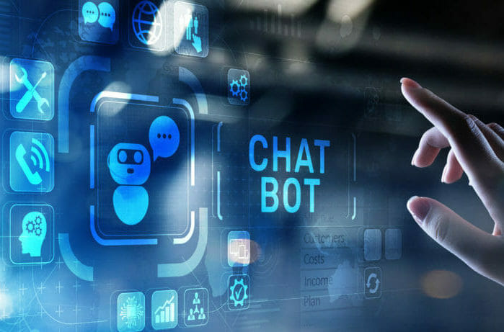
ABOUT
New tools have been designed to simplify the interaction between humans and computers have hit the market: Chatbots or Virtual Assistants. In banking, chatbots and virtual assistants are some of the industry’s newest tools designed to simplify the interaction between humans and computers.
A chatbot is an artificial intelligence (AI) software that can simulate a conversation (or a chat) with a user in natural language through messaging applications, websites, mobile apps or through the telephone.

Slide 4
WORKING
There are two different tasks at the core of a chatbot:
1) User request analysis: this is the first task that a chatbot performs. It analyzes the user’s request to identify the user intent and to extract relevant entities.
2) Returning the response: once the user’s intent has been identified, the chatbot must provide the most appropriate response for the user’s request. The answer may be:
• a generic and predefined text
• a text retrieved from a knowledge base that contains different answers

Slide 5
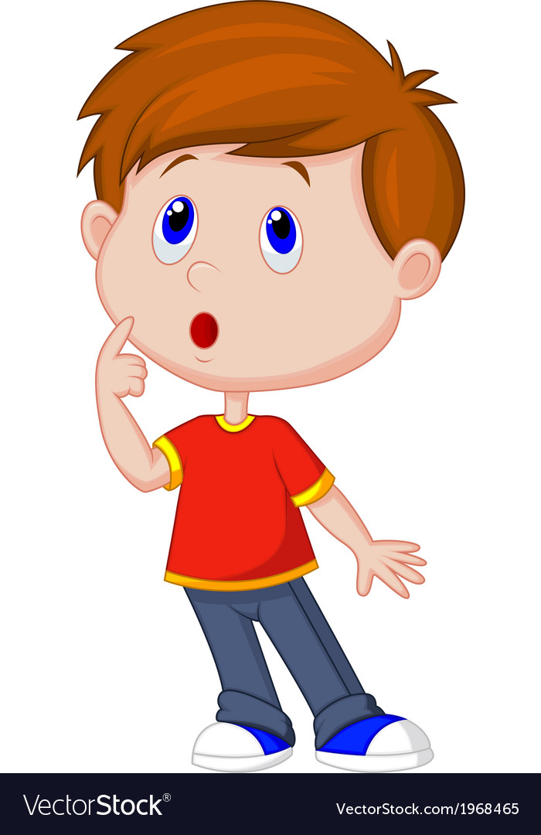
IMPORTANCE
Chatbot applications streamline interactions between people and services, enhancing customer experience. At the same time, they offer companies new opportunities to improve the customers engagement process and operational efficiency by reducing the typical cost of customer service.
To be successful, a chatbot solution should be able to effectively perform both of these tasks. Human support plays a key role here: Regardless of the kind of approach and the platform, human intervention is crucial in configuring, training and optimizing the chatbot system.

Slide 6
TECHNOLOGY USED
We have used here DIALOGFLOW to create our basic Chatbot.
Our Chatbot is based on the theme of ordering cakes and desserts.
What is DialogFlow?: Dialogflow is a natural language understanding platform that makes it easy to design and integrate a conversational user interface into your mobile app, web application, device, bot, interactive voice response system, and so on. Using Dialogflow, you can provide new and engaging ways for users to interact with your product. Dialogflow can analyze multiple types of input from your customers, including text or audio inputs (like from a phone or voice recording). It can also respond to your customers in a couple of ways, either through text.

Slide 7
In our Chatbot we have given some entities named as:
CAKES | ICECREAMS | CHOCOLATE | CUPCAKE
Chocolate | Chocolate | Cadbury Silk | Coconut
Vanilla | Vanilla | Cadbury Oreo | Chocolate
Strawberry | Strawberry | Eclairs | Lemon
Black Forest | Mango | Ferrero Rocher | Blueberry
Black Currant | Butter Scotch | Bournville | Carrot cake
Sponge | Pista | Amul | Cinnamon

Slide 8
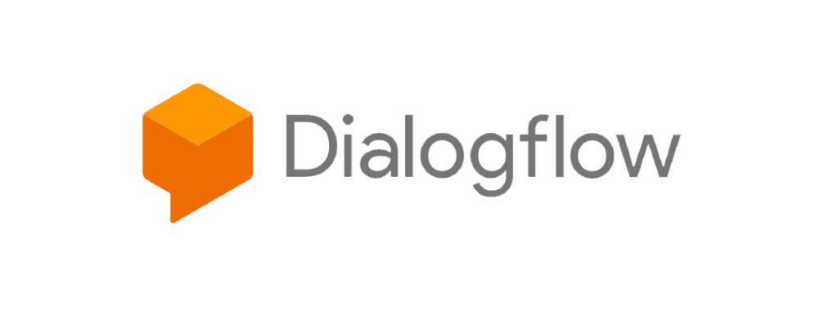
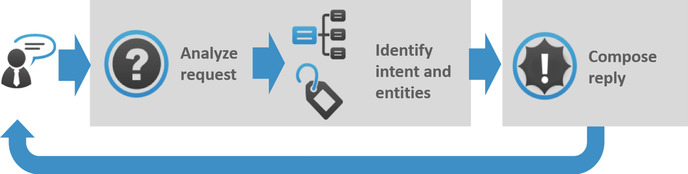
And for quantifying the items we have given the metric as: HALF KG, 1 KG, 2 KG, 5 KG
And after placing the order we have given 3 options as
Yes i.e Order has been taken
No i.e The user is not satisfied with it’s current order and want to place another one.
Cancel i.e The user wants to cancel the order and wants a refund back.

Slide 9
ADVANTAGES
24*7 support – You can not rely on support agents for 24×7 support. Anytime response is important even after business hours when the team is not available. Chatbots can manage such customer queries with automated responses.
Instant answers – Customers simply do not like to wait for assistance — any wait time can lead to frustration and potential churn. Chatbots are a smarter way to ensure that customers receive the instant response that they demand.
Order without human help – Businesses can leverage chatbots to automate bookings of orders and appointments so that customers can instantly book from the website or Facebook page. 47% of consumers would buy items from a chatbot.

Slide 10
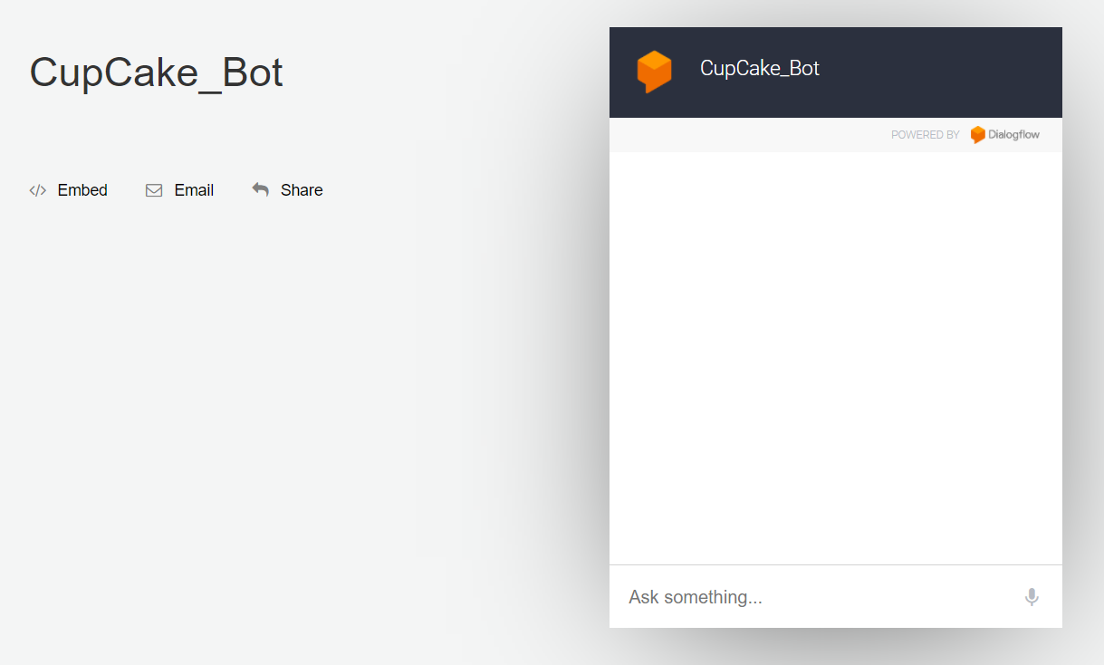
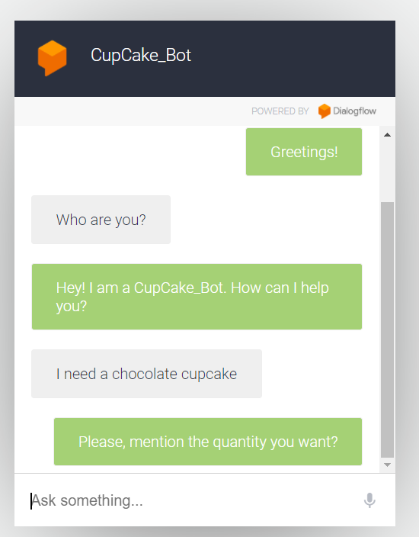
DEMO AND SOME IMAGES

Slide 11
